Slide 1

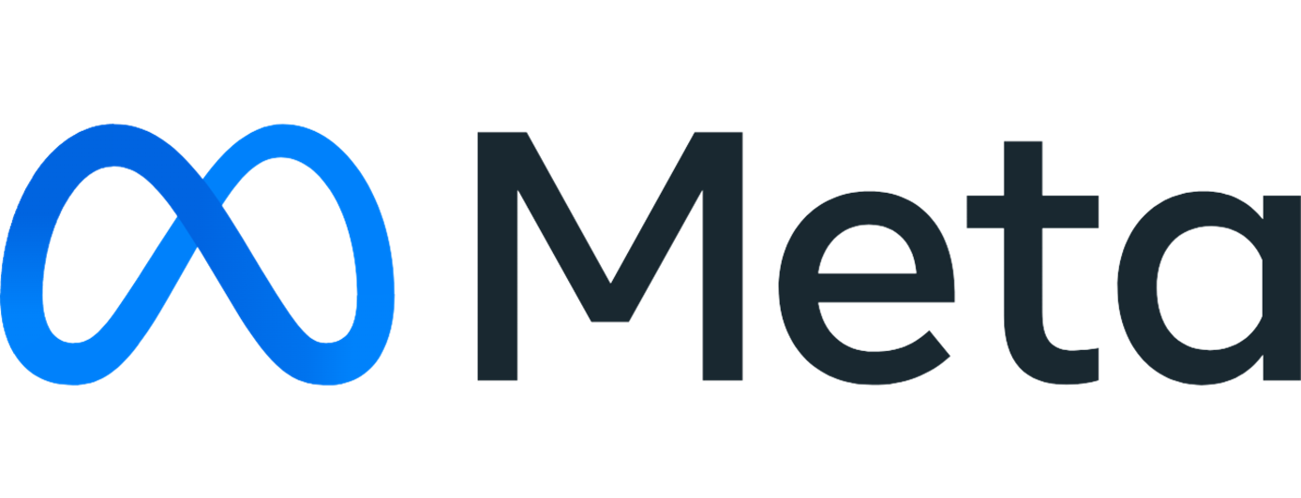
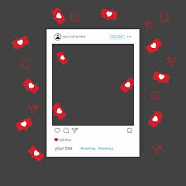
Social Media Analysis
BY -
LAKSHMI KANTHA S

Slide 2
Table of Content
About Meta
Problem Statement
Schema
Data Overview
Approach
Key Metrics
User Classification
User Activity (Photos, Likes, Comments)
Engagement Rate
Recommendation
Conclusion

Slide 3
About meta
Meta, previously known as Facebook, is a technology company founded by Mark Zuckerberg in 2004. In October 2021, it rebranded to Meta to highlight its commitment to developing the “Metaverse” – a virtual reality space where users can engage in shared, immersive experiences.
Meta's ecosystem encompasses popular social media platforms like Facebook, Instagram, and WhatsApp, along with augmented and virtual reality technologies like Oculus. The company envisions creating a digital frontier that seamlessly integrates virtual and physical worlds, enabling people to connect, work, and play in new and transformative ways.

Slide 4
Problem Statement
As a newly hired Data Analyst at Meta, you have been tasked with collaborating closely with the Marketing team. The primary goal of this collaboration is to leverage Instagram's vast repository of user data to craft highly effective targeted marketing strategies.
These strategies aim to drive three critical objectives: enhancing user engagement, improving user retention rates, and boosting new user acquisition.
Your role involves providing actionable insights and well-informed recommendations to address these objectives, ultimately contributing to the development of data-driven marketing campaigns that optimize Instagram's performance and user experience.

Slide 5
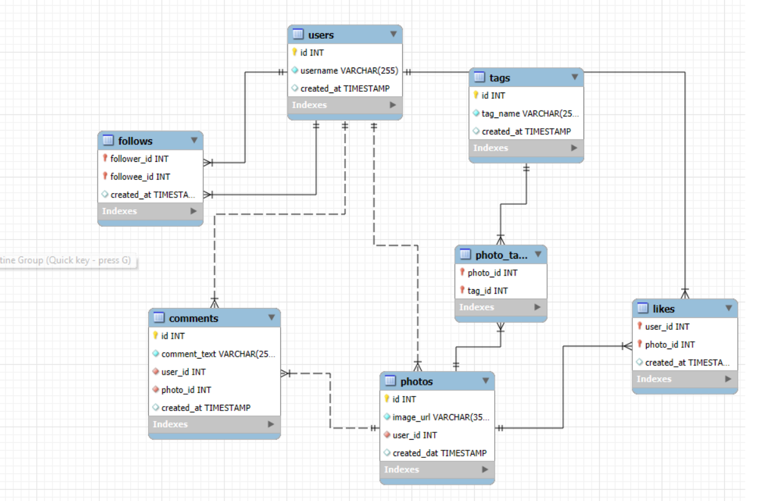
Schema

Slide 6
Data overview
● tag_id: A unique identifier assigned to each tag.
● image_url: The URL linking to an image posted on the platform.
● username: The unique username selected by the user.
● comments_id: A unique identifier assigned to each comment.
● comment_text: The content of a specific comment.
● user_id: A unique identifier assigned to each user.
● photo_id: A unique identifier assigned to each photo.
● created_at: The date when an interaction, such as likes,
photos, or tags, occurred.
● follower_id: The user ID of the follower associated with a particular user.
● followee_id: The user ID of the followee linked to a particular user.

Slide 7

Approach
1. Understanding the Problem Statement Defining the key questions, outlining the objectives of the analysis, and assessing the available data to address them effectively.
4. Data Visualization: Presented key metrics, including total posts, likes, and comments, through visualizations. Developed charts and graphs to rank users by engagement rates and emphasize the most impactful hashtags.
2. Data Cleaning and Validation: Identified and removed duplicate entries from the datasets and addressed any null values.
5. Strategy Development: Formulated plans and strategies aimed at enhancing user retention and boosting engagement activities.
3. Analysis: Performed the analysis using SQL functions such as CTEs, aggregate functions, subqueries, GROUP BY clauses, ranking functions, and more.
6. Implementation: Discussed the execution of the plans and strategies to ensure optimized and improved results.

Slide 8



Key Metrics
By utilizing these metrics, we can calculate the engagement rate of users and categorize them accordingly. This enables the implementation of targeted strategies to address specific challenges.
By utilizing these metrics, we can calculate the engagement rate of users and categorize them accordingly. This enables the implementation of targeted strategies to address specific challenges.
Like
Comment
Photos
LIKES
COMMENTS
PHOTOS

Slide 9
User Segmentation
Of the 100 users, 30% are considered active (high) users.
34% are classified as moderately (medium) active users.
The remaining 34% are inactive (low) users, characterized by a very low engagement rate.
The dataset contains a total of 100 users.
Users who created their accounts before 2017 are categorized as Old Users, while those who registered after 2017 are classified as New Users.
65% of users are Old Users, and 35% are New Users.

Slide 10
User Activity(Likes)
The chart displays the number of likes for each user.
Thirteen users have received 257 likes, the highest number of likes among all users.
The majority of users have fewer than 100 likes.
Additionally, 23 users have not received any likes out of the total 100 users.

Slide 11
User Activity (Comments)
Top Commenters: Thirteen users have made 257 comments, the highest number recorded by any user.
Comment Distribution: The majority of users have made fewer than 90 comments, showing a lower level of interaction.
Inactive Users: Out of 100 users, 23 have not made any comments, contributing to lower engagement.
Engagement Impact: These figures highlight how comment activity significantly influences the overall engagement rate.
User Activity (Comments)

Slide 12
User Activity (Photos)
Posting Activity: Out of 100 users, only 74 have posted photos. The majority (18 users) have made just one post, while only 7 users have posted more than five photos.
User Engagement Trend: As the number of posts increases, the number of users decreases significantly, indicating that most users are minimally active.
Top-Performing Hashtags: The hashtags with the highest engagement rates include #beauty, #delicious, #foodie, #dreamy, #food, #photography, #smile, #stunning, #sunset, and #beach

Slide 13
Top Tags by Average Likes
Calculating Likes Per Tag: The query determines the total likes for each photo and then calculates the average number of likes across all photos associated with each tag.
Grouping and Sorting: The results are grouped by tag name and sorted in descending order based on the average number of likes.Top
Tags Selection: The top 10 tags with the highest average likes are selected and displayed.

Slide 14
Engagement Rate (Top10)
Engagement Rate Calculation: The engagement rate is determined by summing the number of likes and comments for each user.
Top Engaged Users: Karley_Bosco leads with the highest average engagement rate of 166, followed by Kenneth64 (158) and Erick5 (157). Other notable users include Kelsi26 (156), Aiyana_Hoeger and Delpha.Kihn (154), and Rafael.Hickle2 (153).
Overall Engagement Insights: Most users have an average engagement rate below this range, highlighting the need to enhance user experience to drive higher engagement.

Slide 15
Inactive User’s Engagement Ranking
The dataset provides scores for inactive users, along with the count of users corresponding to each score.
Identifying Low Engagement Users: The query analyzes user activity metrics, including photos posted, comments made, likes given, followers, and following, to calculate an overall engagement score.
Ranking by Engagement Score: Users are ranked in ascending order, with the lowest engagement score receiving the highest rank (rank 1).
Final Output: The results display the user ID, username, engagement score, and rank, highlighting the least engaged users on the platform.

Slide 16

Recommendation
Re-Engaging Users
Leverage Instagram Insights:
Analyze user interests and interactions to gain a deeper understanding of their preferences.
Create content tailored to specific user segments based on factors like age, location, and interests.
Personalized Re-engagement Emails:
Send customized emails highlighting trending content or posts from their connections they might have missed.
Recommend content, groups, or hashtags aligned with their past behavior and interests.
Hashtag Targeting:
Research trending and popular hashtags within your niche.
Identify hashtags that resonate with your brand and audience.
Incorporate these hashtags strategically in your content and ad campaigns.

Slide 17

Recommendation
Re-Engaging Users
Offering Discounts and Gift Cards:
Rewarding users with discounts or gift cards is a proven and effective
method to show appreciation.
2. These incentives are exciting for users and encourage them to engage more with your platform.
Collaborating with Influencers:
Partner with influencers who have high follower counts and strong engagement rates.
Focus on individuals whose content aligns with your brand values and target audience.
Clearly define campaign objectives and track influencer performance using Instagram Insights.
Organizing Contests:
Launch challenges or contests that offer rewards for the most engaging content or achieving specific activity milestones.
Use these contests to motivate users to interact more actively with your platform.

Slide 18
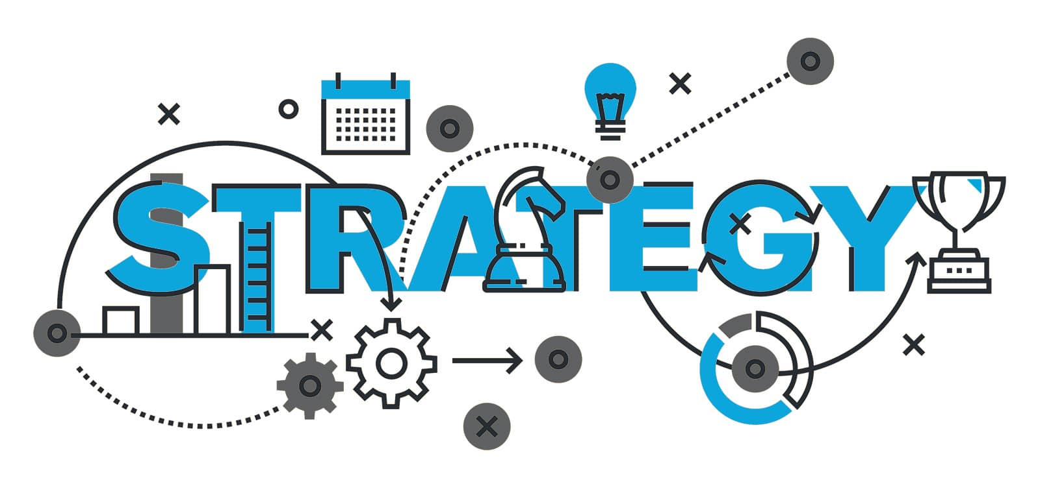
Recommendation
User Retention Strategies
Targeted Campaigns:
Identify inactive users using historical data.
Create personalized content and offers to encourage re-engagement.
Leverage Instagram features like Stories and Reels to reconnect with users effectively.
Simplifying User Interaction:
Provide templates or prompts to make content creation and sharing easier, reducing the effort required for users to participate.
Programs and Meetups:
Design programs that reward consistent engagement and interactions.
Utilize Instagram features such as badges and rewards to recognize active users.
Partner with influencers to promote loyalty programs and drive participation.

Slide 19

Recommendation
User Retention Strategies
4. Custom Titles or Badges:
Offer custom titles or badges to help users stand out and feel valued, fostering a sense of exclusivity and recognition.
5. Gathering Feedback:
Reach out to inactive users and ask for feedback on why they stopped engaging.
Use their insights to implement meaningful changes or offer tailored solutions.
6. Data-Driven Insights:
Analyze historical data of inactive users, such as their first follows or liked posts.
Use these insights to refine your content strategy and create personalized experiences that resonate with their preferences.
Offer custom titles or badges to help users stand out and feel valued, fostering a sense of exclusivity and recognition.

Slide 20
Conclusion
The analysis categorizes users into three segments: Active Users, Moderately Active Users, and Inactive Users, with a primary focus on re-engaging Inactive Users.
Hashtags play a crucial role in boosting user engagement and content promotion. Therefore, they should be carefully monitored and aligned with trending and hot topics for maximum effectiveness.
Reels have emerged as a highly engaging format, particularly among new users. Efforts should be made to encourage users and influencers to create reels using trending hashtags to amplify reach and interaction.
Ads and campaigns should be optimized to align with ongoing trends, ensuring they remain relevant and impactful.
Lastly, notifications via push alerts, emails, and SMS should be strategically utilized, with A/B testing conducted to refine and enhance promotional efforts.

Slide 21


